Slide 1

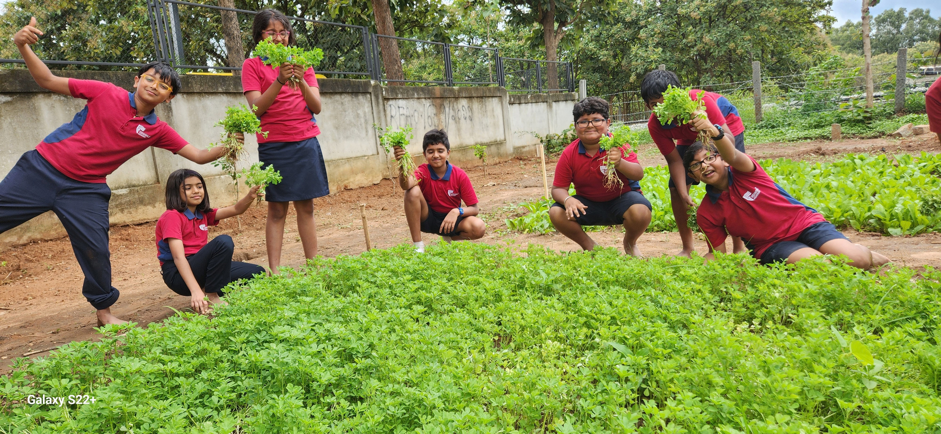
Project Title-School Garden & Composting
Vision
Soil becomes a classroom.
Waste becomes a resource.
Students become its custodians.

Slide 2
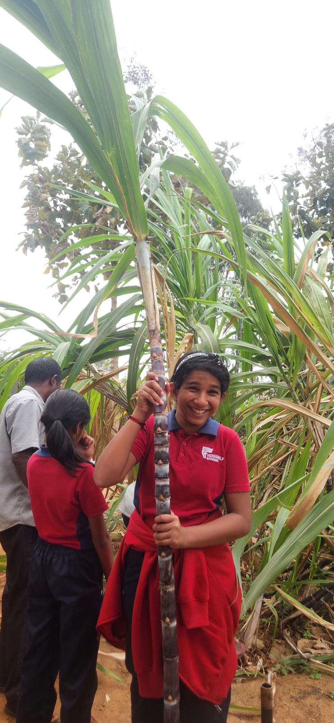
Mission:
As India’s First Fairtrade school , our mission is to bridge the gap between environmentallearning and everyday action.

Slide 3
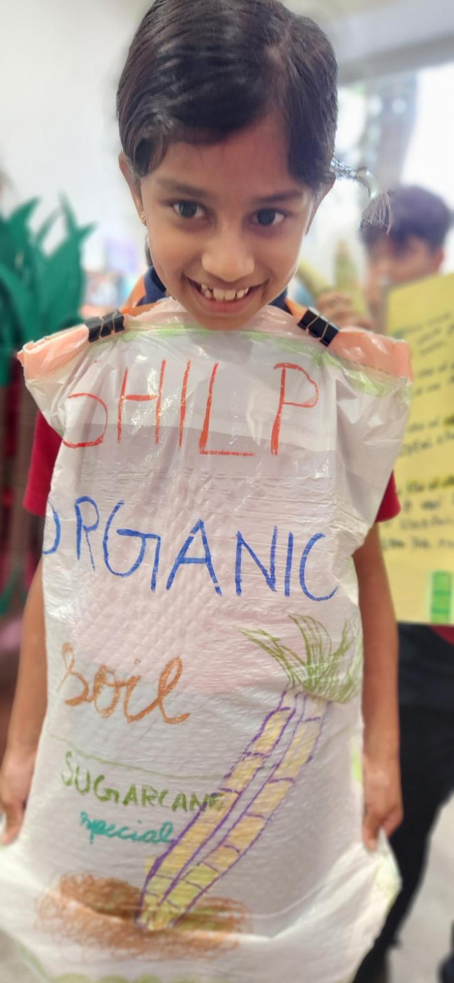
Key Sustainable Development Goals (SDGs) Addressed
SDG 4 (Quality Education): School farms act as living laboratories for experiential learning in science, math, biology, and environmental conservation.
SDG 2 (Zero Hunger / Sustainable Agriculture): Educating students sustainable food production, crop diversity, and local food security.
SDG 3 (Good Health and Well-being): Promoting nutritious, chemical-free food and reduces non-communicable diseases by serving locally grown crops in cafeterias.
SDG 12 (Responsible Consumption and Production): Introducing principles of composting, water conservation, and reducing food waste.
SDG 15 (Life on Land): Fosters a sense of responsibility toward natural biodiversity, soil health, and conservation.

Slide 4
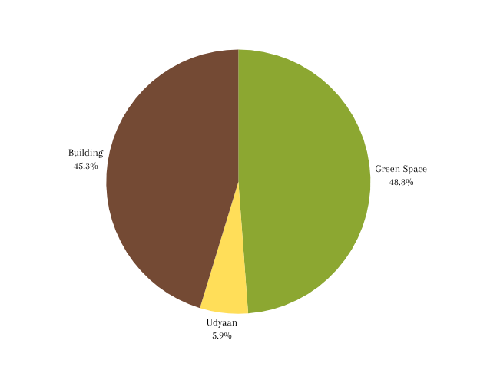
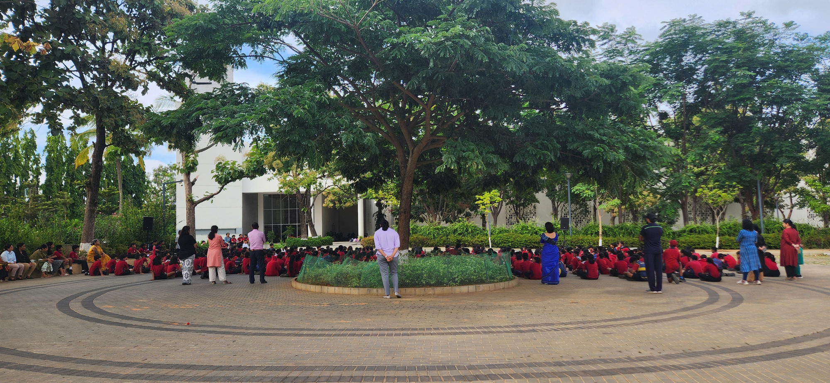
Our Campus
Total Land Area : 17 acres
Total green area : 8.3 acres (48.8%)
Shilp Udyaan area : 1 acre (5.9%)
VSA Community
Students : 2500
Staff : 500
Parent community

Slide 5
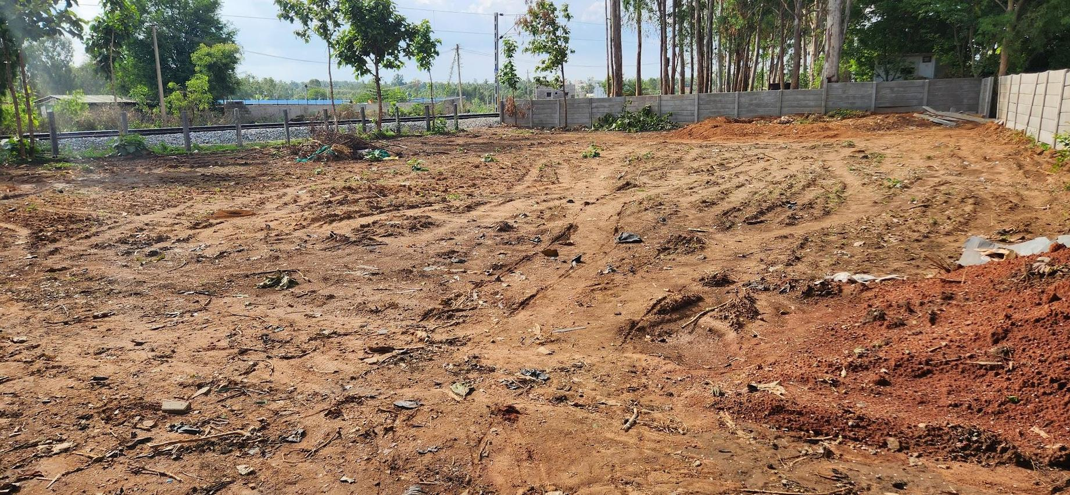
Our new Classroom
An acre of unused land became our new classroom in 2023

Slide 6
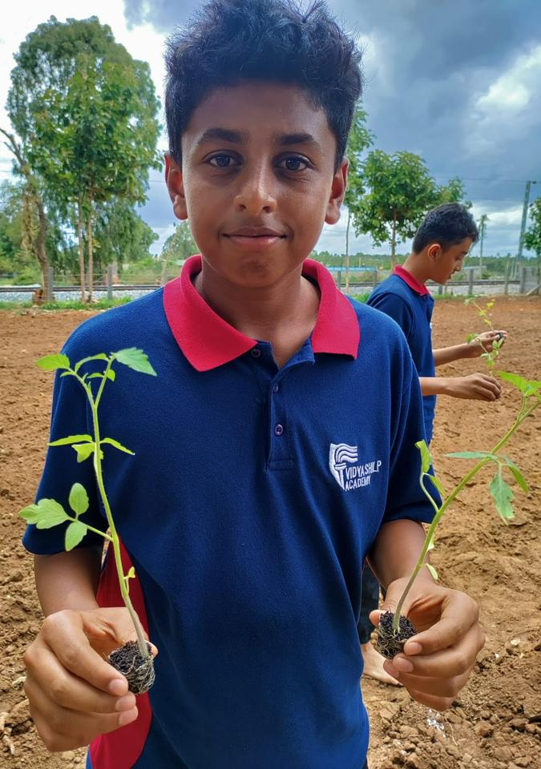
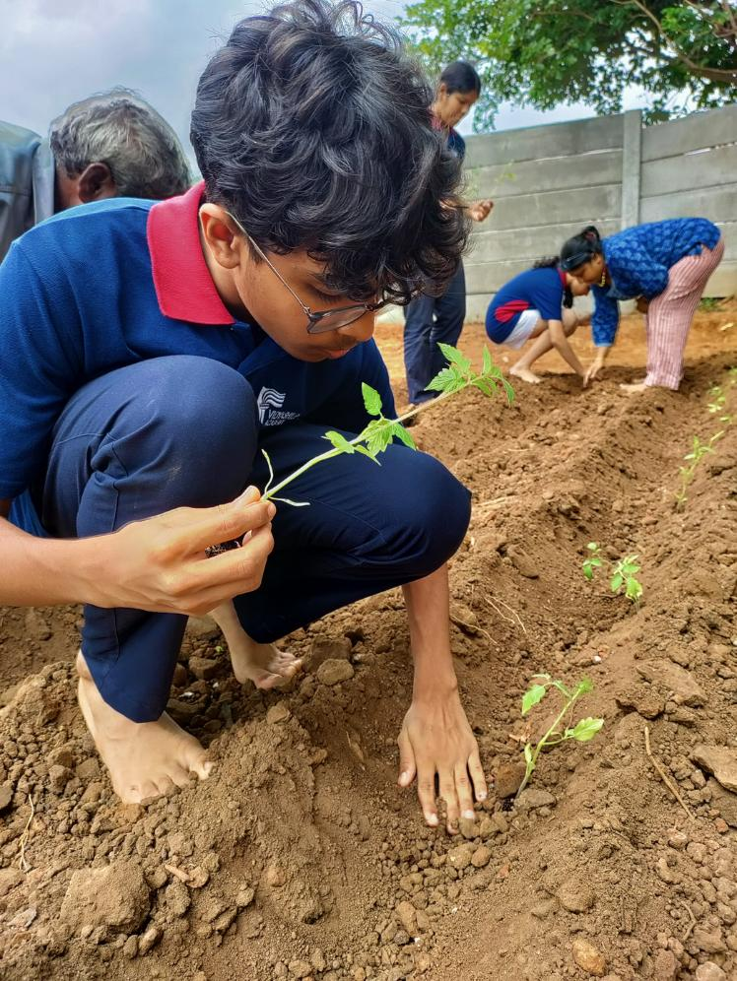
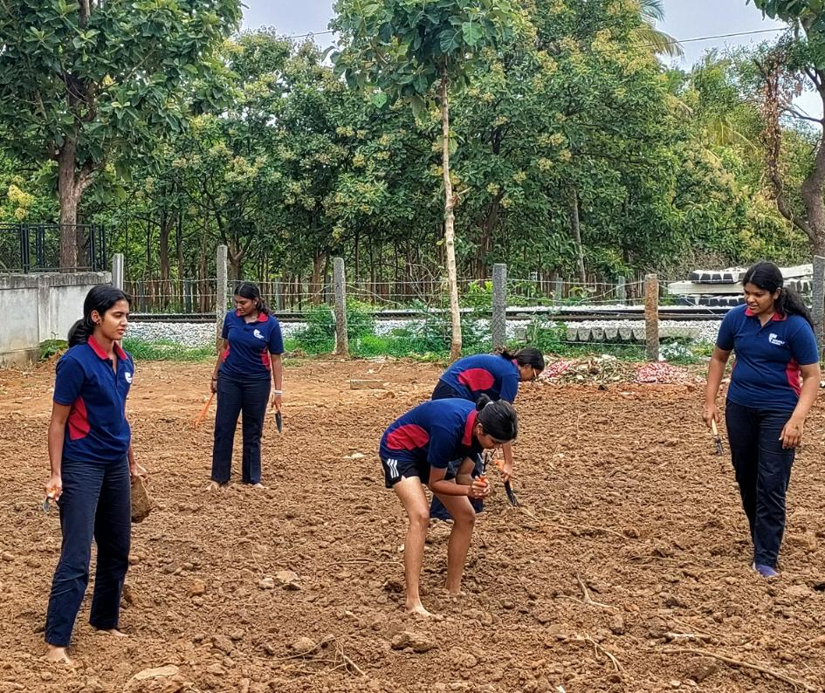

Soil, our new Black Board
Soon the focus shifted from
cultivating land to
cultivating “seeds of possibility”

Slide 7
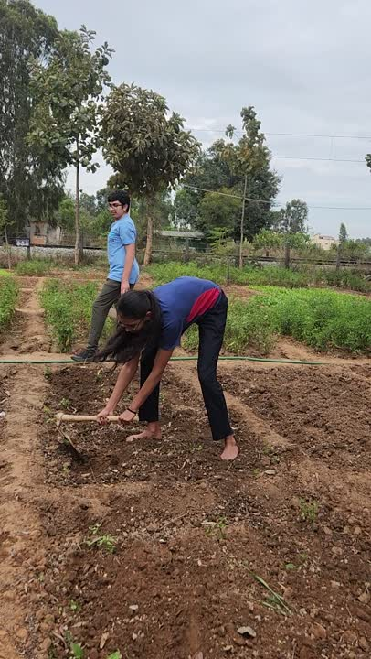
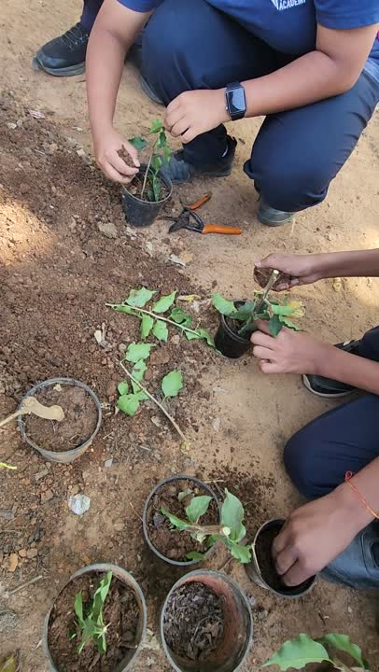
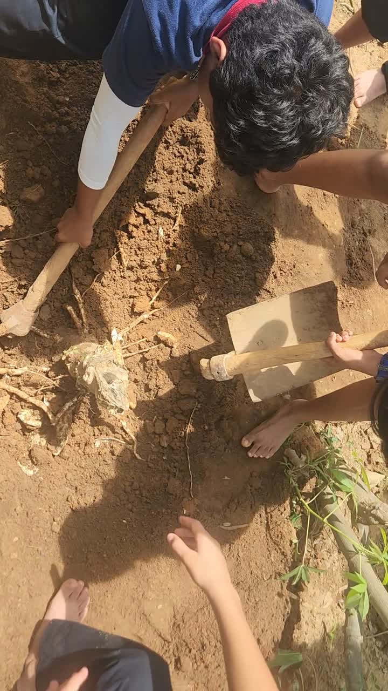
The ‘Live’ Classroom
Udyaan became a living classroom.
Preparation(for sowing)
Learning by doing (grafting and repotting)
Results (Harvesting tapioca)
Active Physical Participation
Experiential Knowledge
Life skills and values

Slide 8
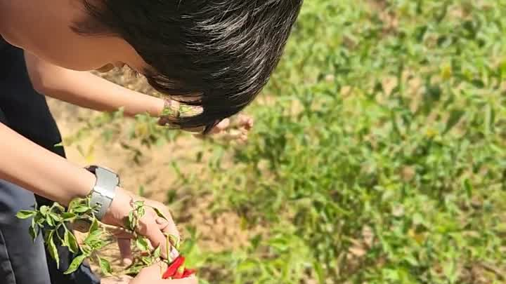
New Learnings from “New Classroom”
  QUESTION
Where does our food come from?
  EXPERIENCE
Sowing • Nurturing • Harvesting
  LEARNING
Understanding food, farming and
Nature
  LIFE SKILLS
Patience
Responsibility
Care
Harvesting of green chillies by students of Grade 6

Slide 9
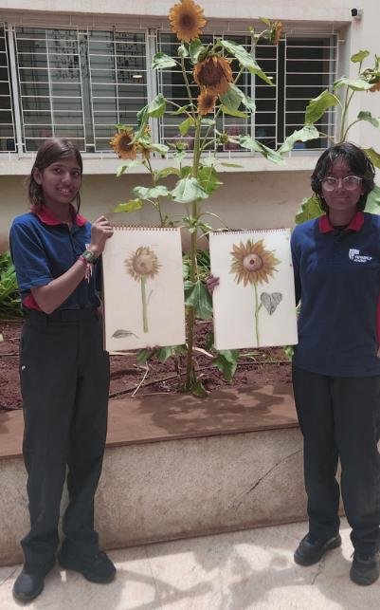
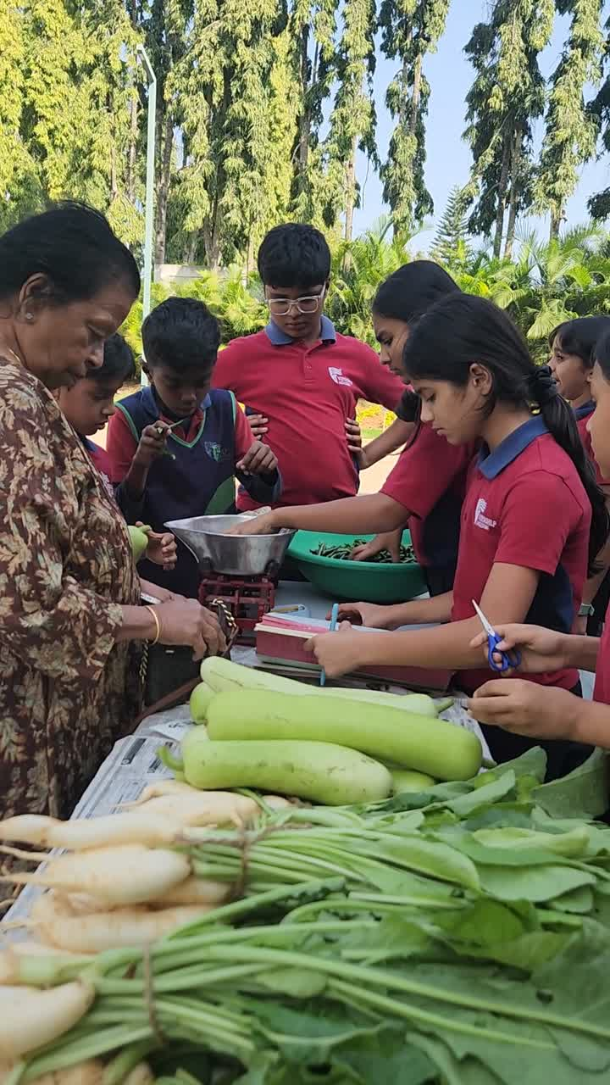
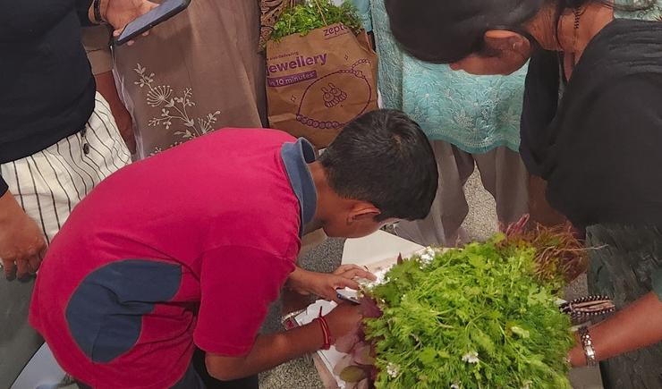
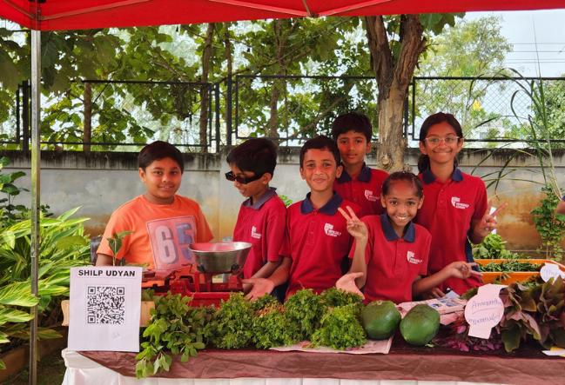
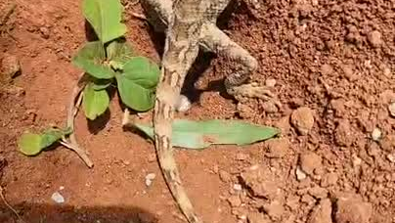
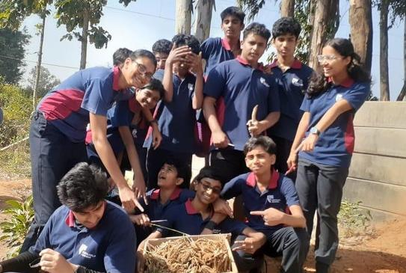
Many diverse Learnings
Art & Creativity
Numeracy skills- measuring, weighing and
calculating yield
Entrepreneurship skills
Design and problem-solving skills
Environmental education
Social and interpersonal skills

Slide 10
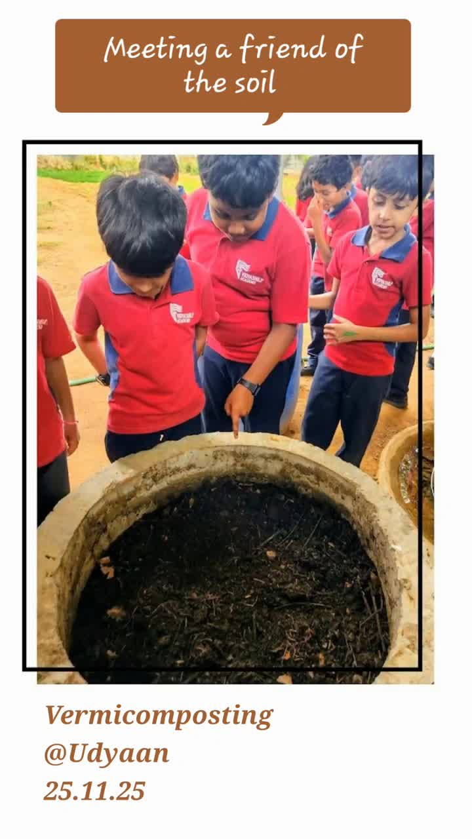
Learning How to Manage Waste Resource
Waste transformed into a resource for Shilp Udyaan.
SHILP KITCHEN serves
~3,000 MEALS
EVERY DAY
↓
generating
100Kg OF ORGANIC WASTE
↓
400Kgs of
nutrient rich
COMPOSTING + VERMICOMPOSTING
  QUESTION #1
What happens to the waste we
throw away?
  EXPERIENCE
Composting to Harvesting
Vermicompost
  LEARNING
Understanding how organic waste
can be transformed into a valuable
resource for growing plants
  LIFE SKILLS
Responsibility
Resourcefulness
Sustainability

Slide 11
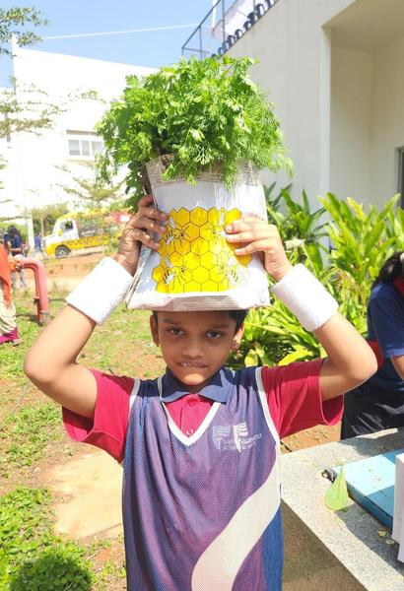
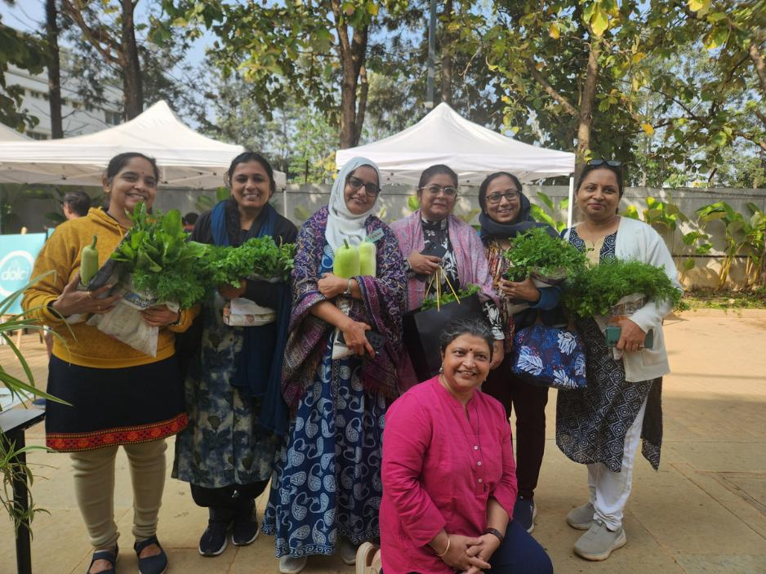
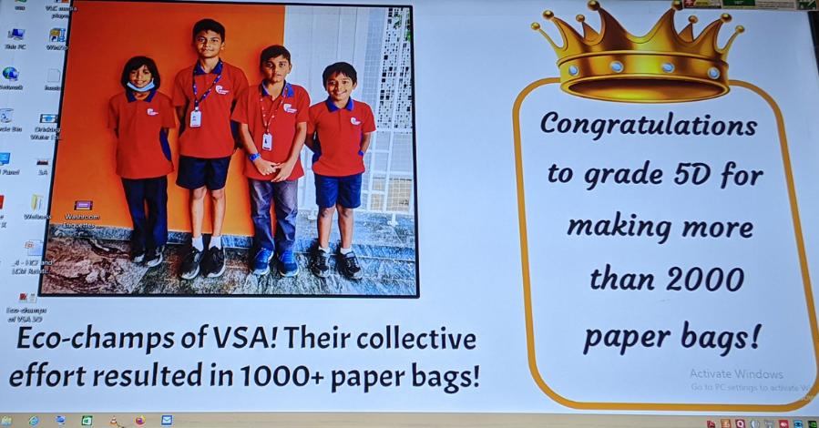
Learning to be Responsible Producers / Users
  QUESTION #2
Can something we consider waste
be given a new life?
  EXPERIENCE
Reuse , Repurpose and Create
  LEARNING
Understanding waste reduction,
resource conservation and the
value of reusing materials instead
of discarding them.
  LIFE SKILLS
Responsibility
Resourcefulness
Creativity
Supporting local, sustainable choices - Recycled Paper and Cloth Bags
Celebration of milestones in Paper Bag Making

Slide 12
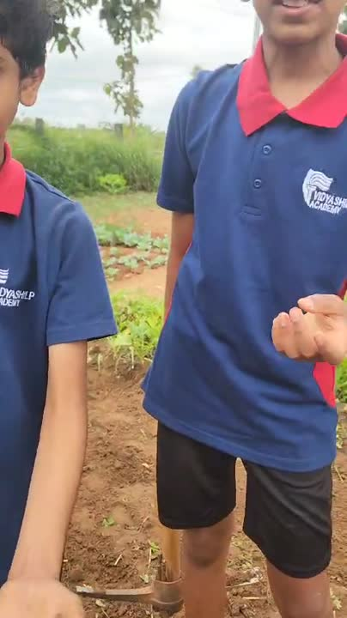
Practical Learning - Caring & Sharing with all
  QUESTION
Who shares our garden with us?
  EXPERIENCE
Observing and interacting with soil, plants,
insects, birds and other living beings.
  LEARNING
Discovering how every living organism is
connected and contributes to the
ecosystem.
  SKILLS & VALUES
Observation
Empathy
Respect for Biodiversity
“Understanding our role in Ecological Interdependence”

Slide 13
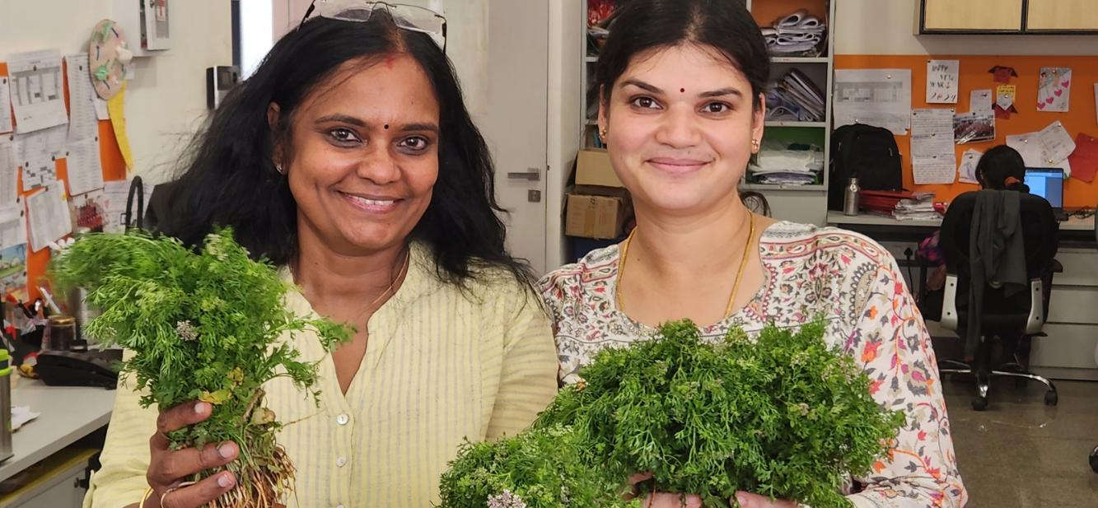
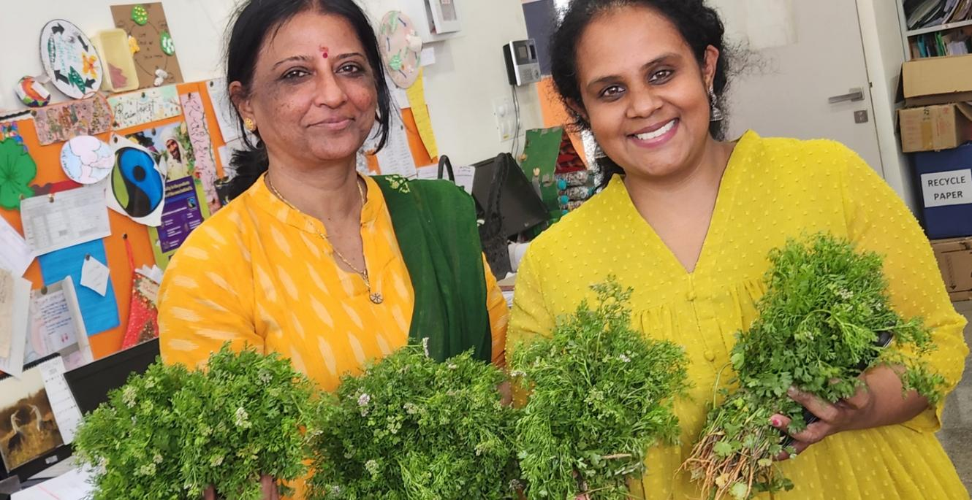
Learning to Achieve Common Goal through Partnership
Students, educators, families and experts came together towards a shared goal.
Seed to Grain
From Paddy to Ragi
Pickle and Guppy Tales
Interactions with Fairtrade Cotton Farmer
Collaborating with Farmers @ GKVK

Slide 14
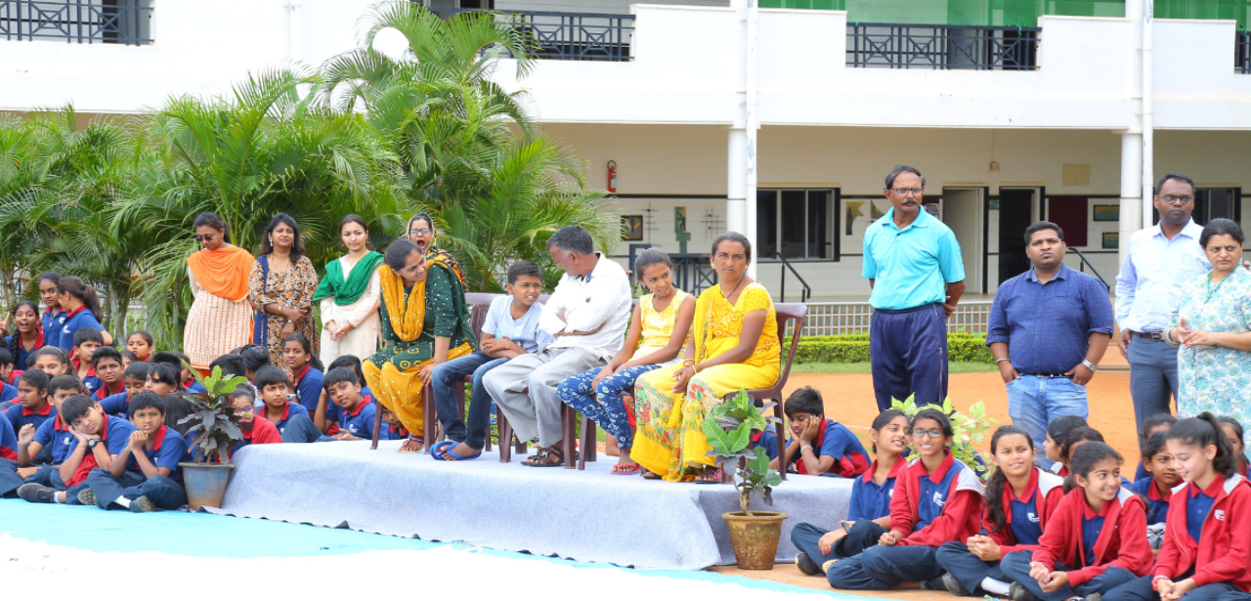
Hosting Cotton farmer Sarvaiya Pravinkumar Nagajibhai and his family opened new channels of interactions.

Slide 15
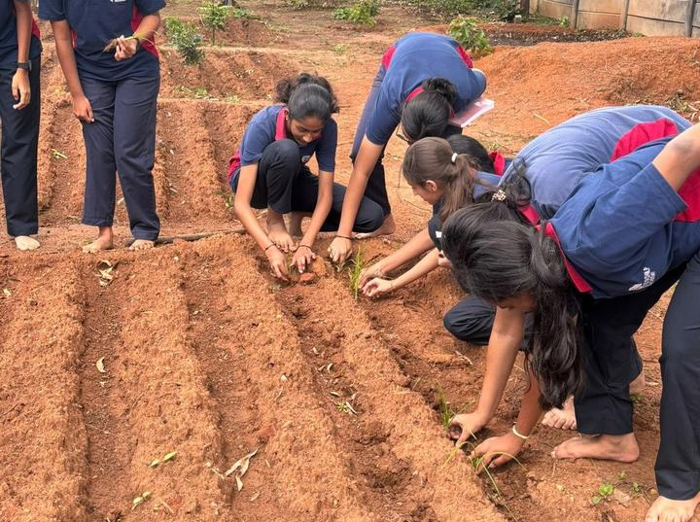
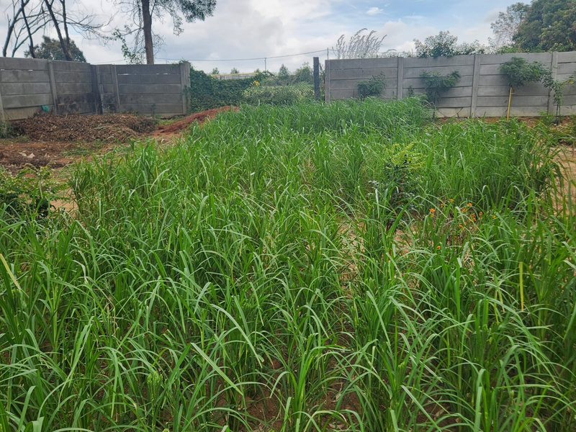
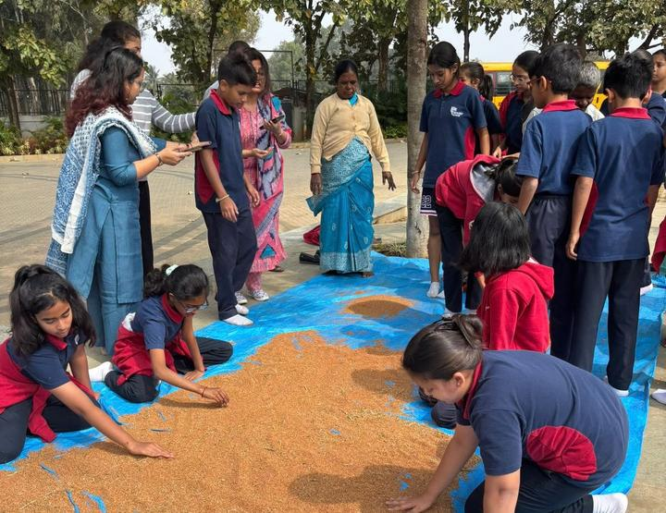
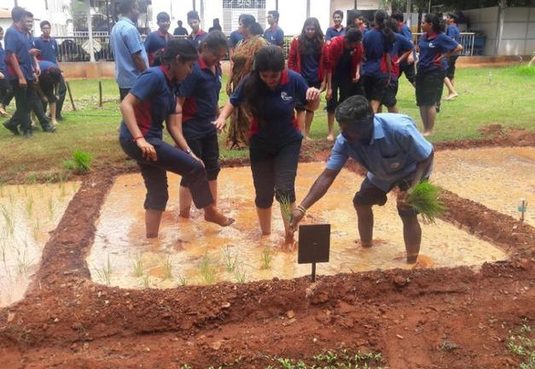
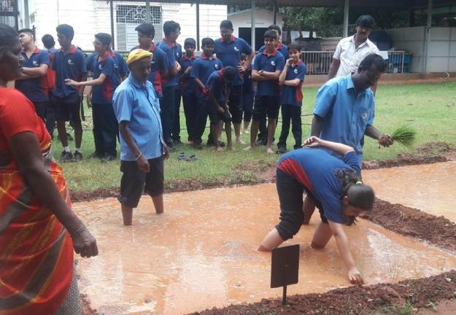
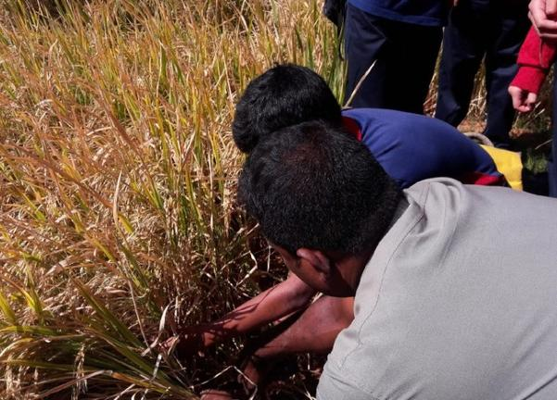
Collaboration and Partnership at Udyaan
2023-24- Year of the Millets: Udyan students of grade 8 cultivated 20 kgs of ragi millet
2018- Basmati cultivation undertaken under the guidance of our grandma Mrs. Leelavati

Slide 16
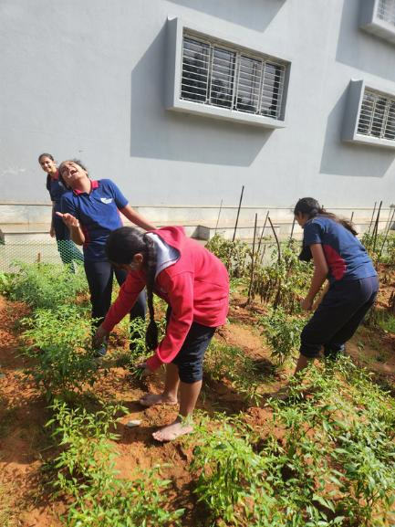
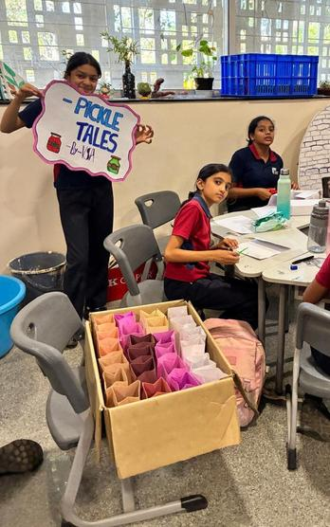
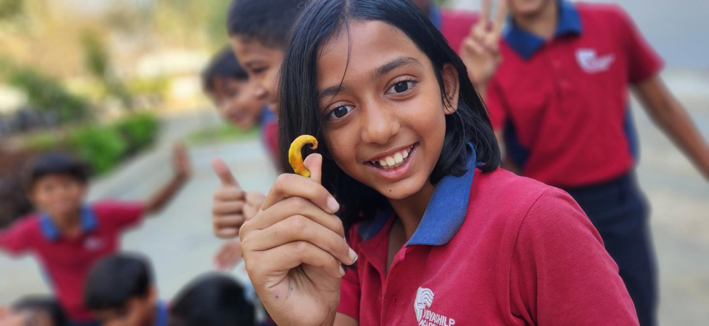
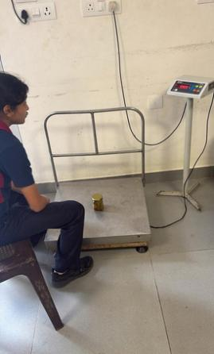
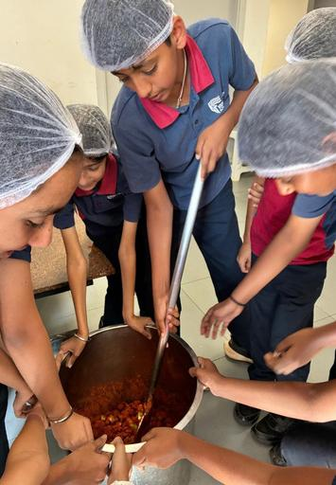
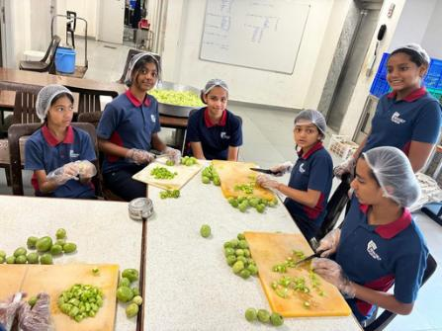
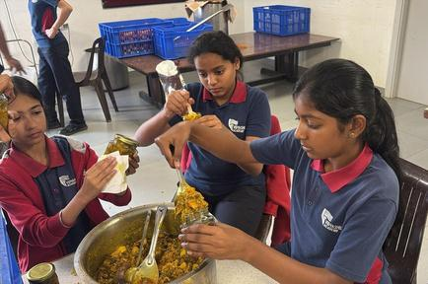
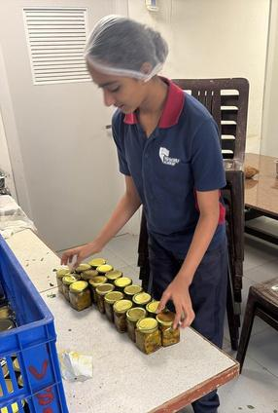
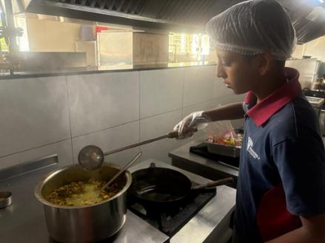
120 bottles of pickles made from Udyaan grown chillies and tomatoes became an instant hit with parents and guests at Independence day Celebrations
PICKLE TALES

Slide 17
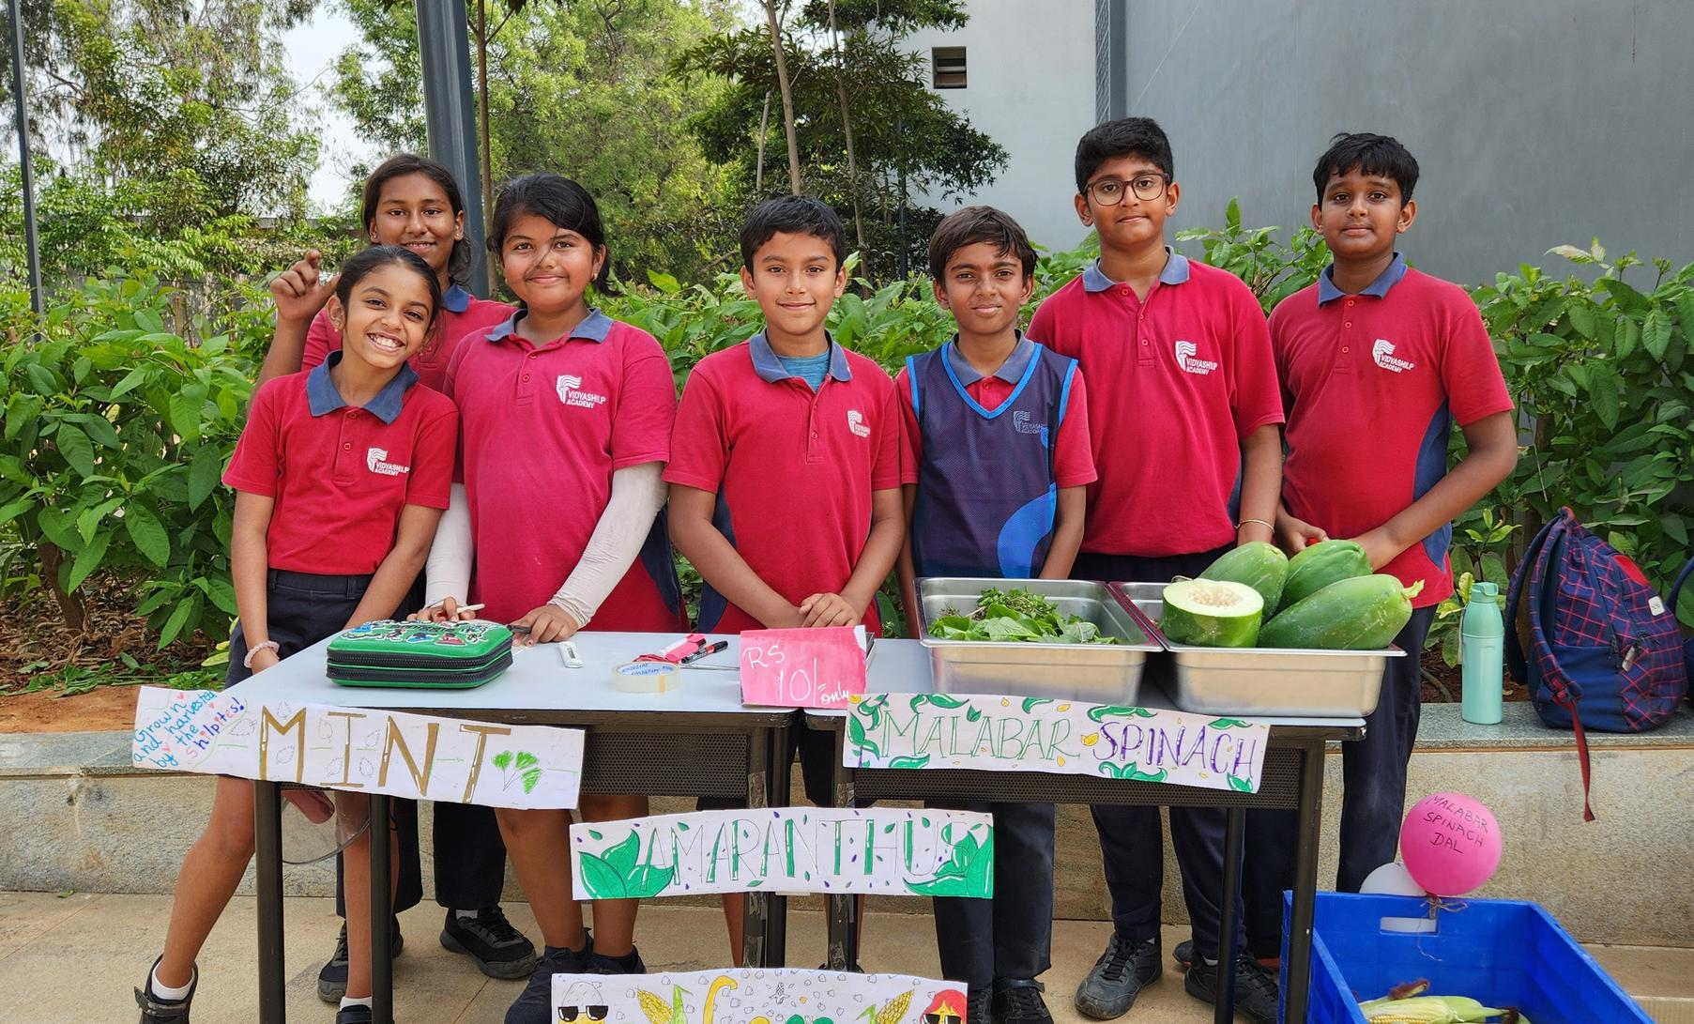
IMPACT

Slide 18
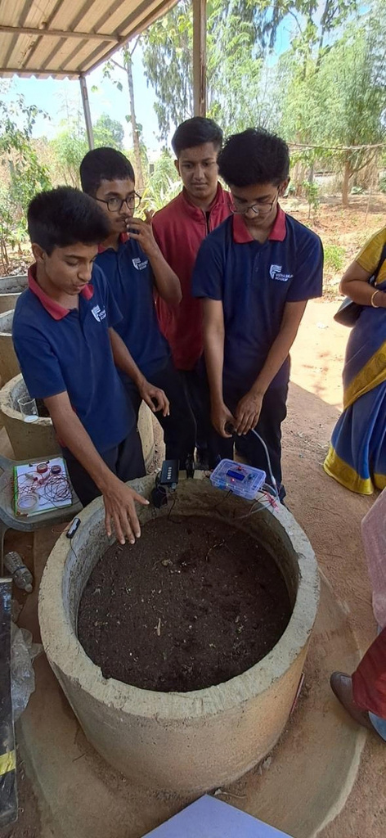
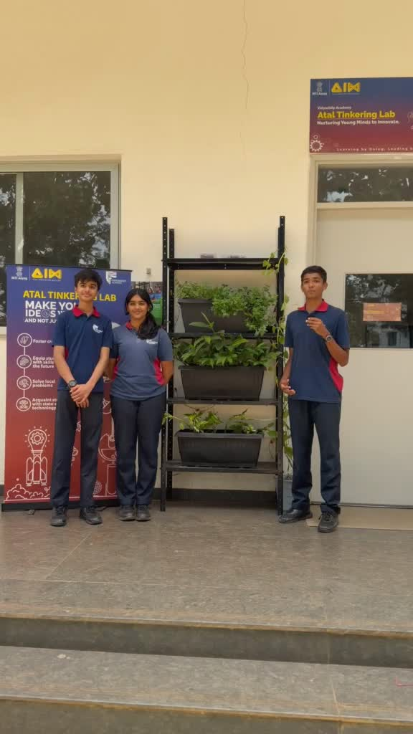
UDYAAN inspired Innovation and start-up ideas
In 2026, a visiting NITI Aayog team selected two Udyaan-inspired student innovations as approved project ideas:
Smart Vermi compost bin- Developed a sensor-based device to monitor key parameters of the composting bin, enabling students to understand and optimise the composting process.
Automated vertical Garden system- Exploring efficient ways to grow food in limited spaces

Slide 19
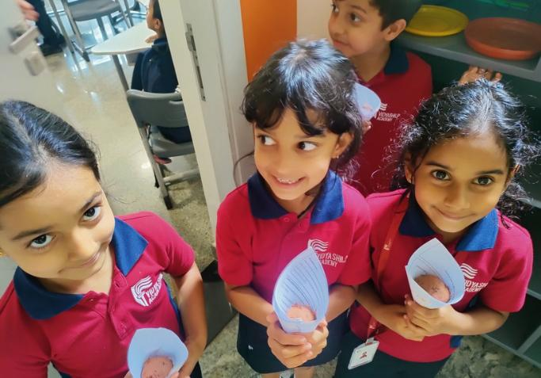
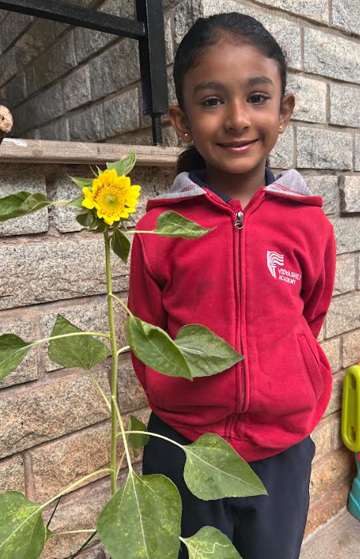
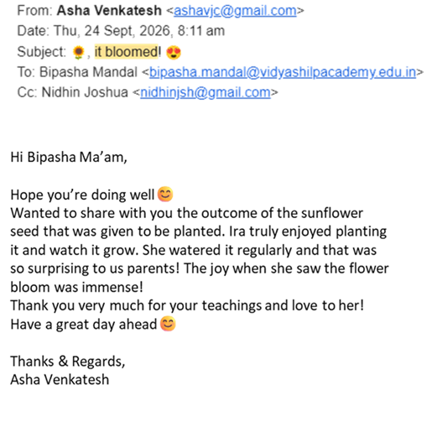
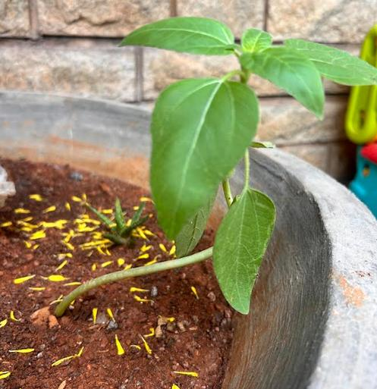
“It Bloomed! - “From a seed in Udyaan .... to a seed of learning at home.”

Slide 20
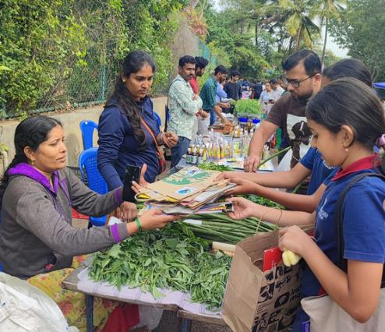




FROM UDYAAN TO COMMUNITY ACTION
In a creative and impactful initiative, Shilpites collected paper bags and crafted new ones from recycled newspapers. These eco-friendly bags were then distributed at GKVK Sante, where students also engaged vendors in meaningful conversations about reducing plastic use and embracing sustainable practices. The school children promise to relentlessly pursue this inititiatve every month.....

Slide 21



Testimonials:
“I Want to be a Farmer when I grow up”
-Student Sahana
“Impressive initiative ... please keep it on”
-Parent
“Very tasty......”
-Educator Sindhu

Slide 22


A seed was planted → the garden grew → the learners grew → the community grew → the idea continues to grow.
Thank You for support and encouragement
@ Shilp Udyaan

